Slide 1
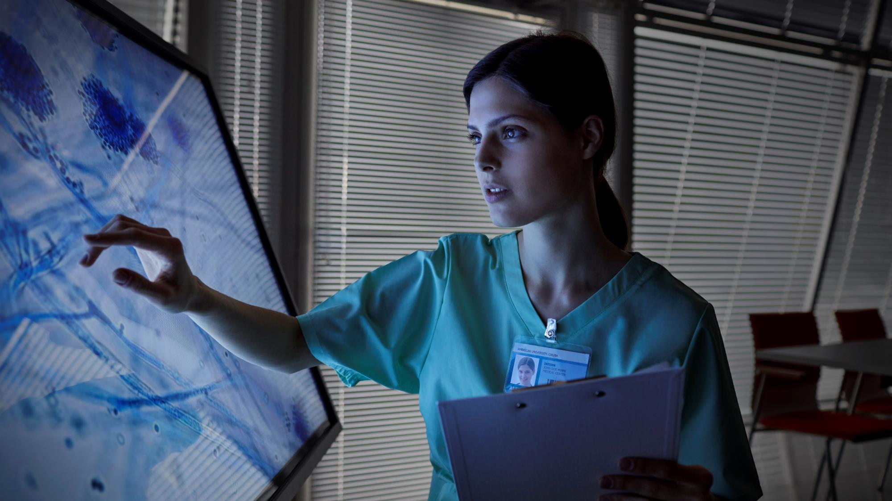
Mr. Wellness- “ Your Health Monitor ”.
Group Project

Slide 2

ABOUT US
GROUP NO. 6
HARPREET KAUR-20BCS4619
PARDARSHEE PRIYA-20BCS4614
RONAK KUMARI-20BCS4635
SMITA SHINDE-20BCS4643

Slide 3
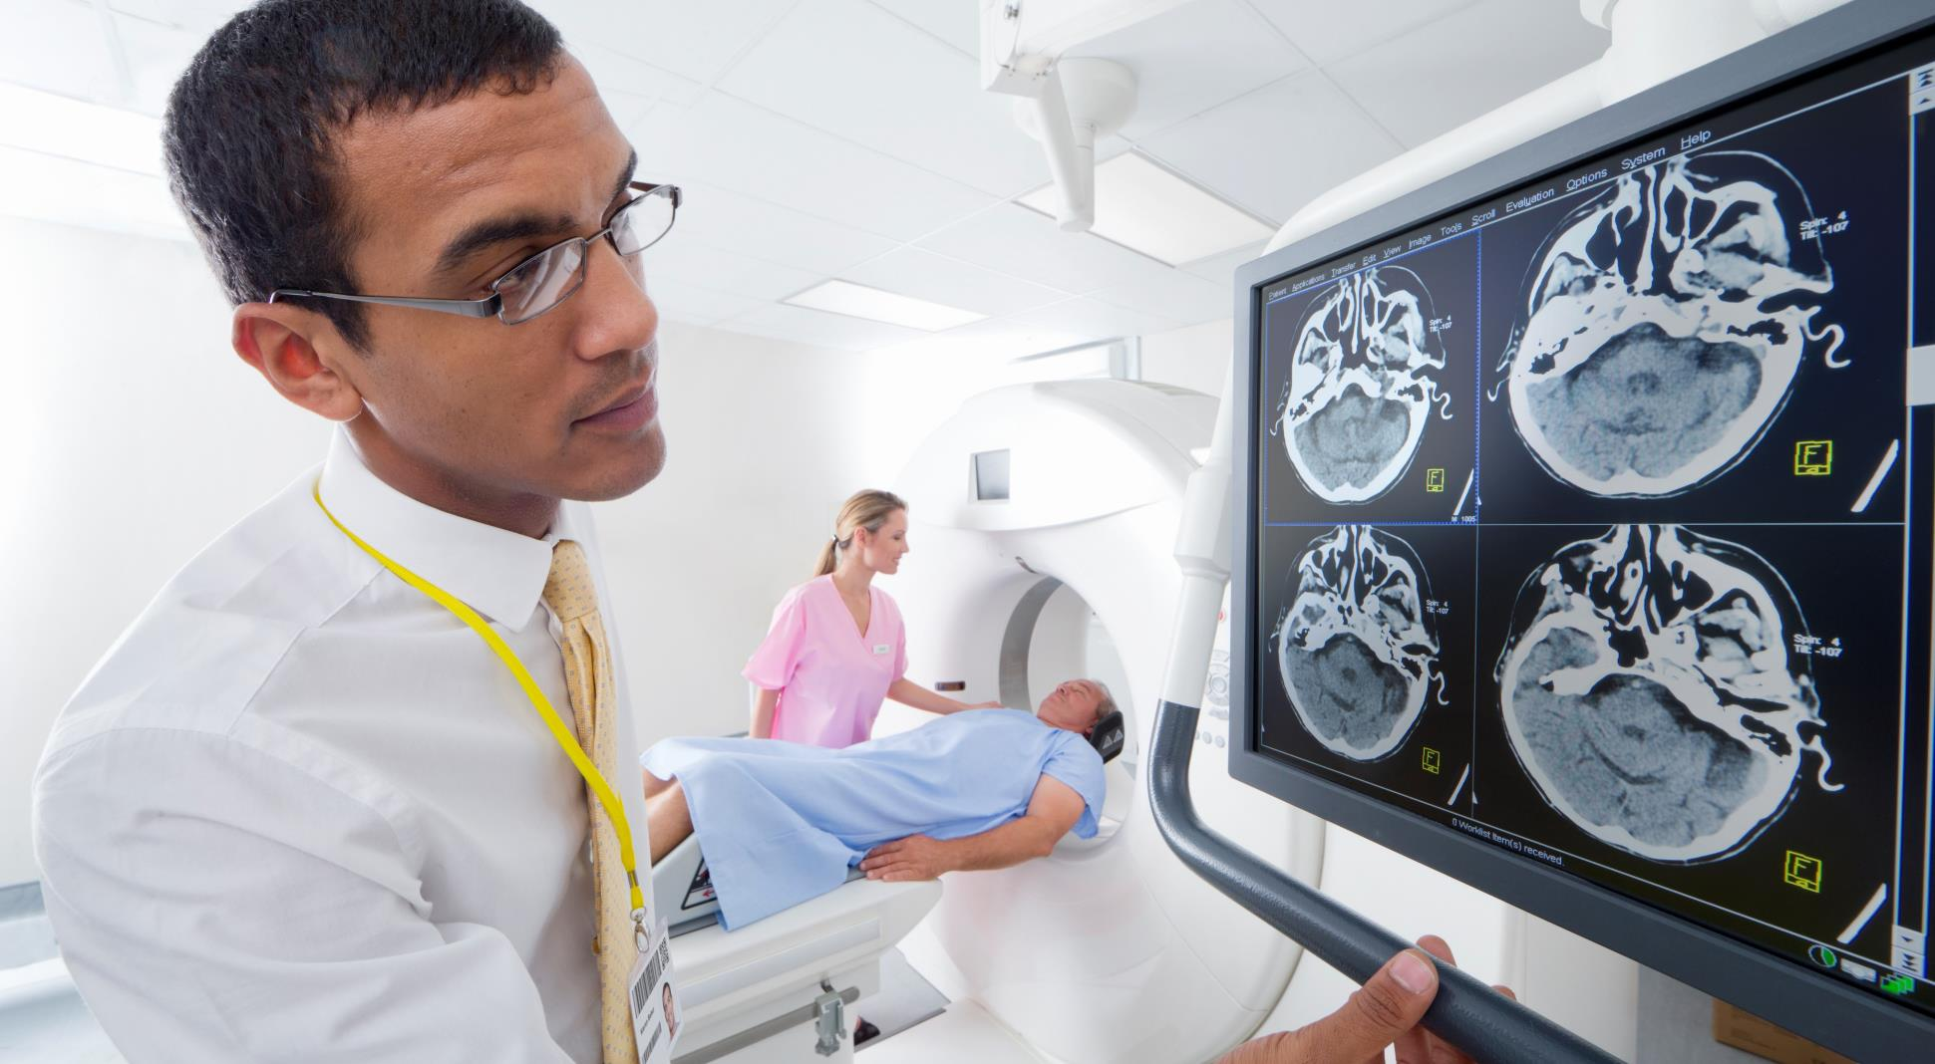

ABOUT THE PROJECT
Mr. Wellness- “ Your Health Monitor ”.
Our Project is IoT based, which is Health Monitoring System that monitor the health status of the patient on esp32 web server. The proposed project can collect and send patient’s health data to an IoT cloud server such as ubidots stem where real time health status of the patient can be recorded and monitored in a remote location where a healthcare professional is present.

Slide 4
KEY FEATURES
Inbuilt AI assistant
Monitors Body temperature
Detects Pulse Rate
Scans Body oxygen level
Easily accessible to both Patients and Doctors

Slide 5
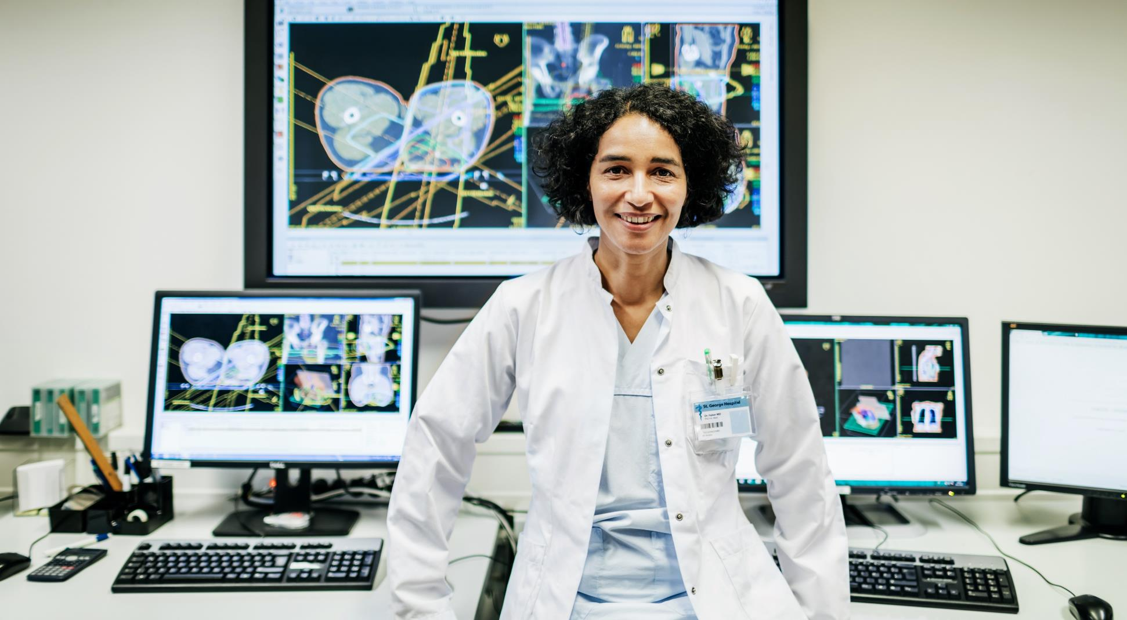
ILLUSTRATION
It saves time of both Patient and Doctor
Monitors health data of Patient
Real time data accessible to Professionals
Notifies immediately, if in emergency case
Recommend medicines through AI, if in emergency state

Slide 6

WHY?? Mr. Wellness- “ Your Health Monitor ”
This project is significant in various ways because in today's world, everyday many lives are affected because the patients are not timely and properly operated. Our system is designed to be used in hospitals and homes also for measuring and monitoring various parameters like temperature, heart rate, blood pressure. The results can be recorded using Arduino. Also, the doctors can see those results on android app. The system will also generate an alert notification which will be sent to doctor. Our system is useful for monitoring health system of every person through easily attach the device and record it. In which we can analysis patient’s condition through their past data, it will recommend medicines if any emergency occurred through symbolic A.I

Slide 7
MOTIVATION
Everyday many lives are affected because the patients are not timely and properly operated. Also, for real time parameter values are not efficiently measured in clinic as well as in hospitals. Sometimes it becomes difficult for hospitals to frequently check patient’s conditions. Also, continuous monitoring of ICU patients is very difficult. In Covid-19 Pandemic, social distancing and to be self-reliant persuaded us towards this project.

Slide 8

SUMMARY
Mr. Wellness- “ Your Health Monitor ”.
We hope that we succeeded in conveying our idea of the project to all of you. It is just a prototype which was created in by small recourses in a limited time frame.
We have tried our very best to make it easy, simple and customizable according to the needs of the user.

Slide 9

Thank you
CHANDIGARH UNIVERSITY
GROUP NO. 6
20bcs4614@cuchd.in
20bcs4619@cuchd.in
20bcs4643@cuchd.in
20bcs4635@cuchd.in

